Slide 1

Rock Paper Scissors
Submitted by:
Aekeesh Jaiswal [RA2311003030006]
Shambhavi Trivedi [RA2311003030051]
Vaishnavi Singh [RA2311003030064]

Slide 2

Introduction
"Rock, Paper, Scissors" is a simple, classic hand game that can be easily implemented in Python. The game involves two players, where each selects one of the options: rock, paper, or scissors. The winner is determined by a set of rules: rock beats scissors, scissors beat paper, and paper beats rock. By creating a Rock, Paper, Scissors game in Python, one can learn how to structure simple programs, use control flow, and work with the randomization feature for generating the computer's move.
It is a game constructed using tkinter library. ThIs game is GUI. The game contains sign up page /login page, welcome page, main game page, result page, leaderboard page. Login /Sign up page and leaderboard is connected to database to store data of players. In Leaderboard page there is option to switch theme (Light and Dark) also leaderboard will show names of all the players (Signed up players), matches played, matches won, matches lose, matches tied.

Slide 3
Objectives:
Grasp fundamental Python programming concepts like loops, conditional statements, and functions.
Learn to handle user input and compare it with computer-generated choices.
Implement the logic for determining the winner based on the game rules.
Develop basic randomness by using Python's `random` module for computer choices.

Slide 4
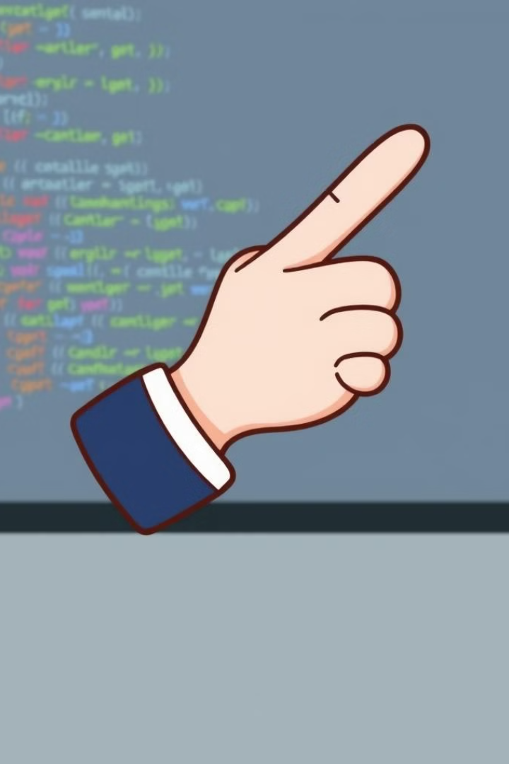
Benefits:
Strengthens logic building: Helps in learning control structures and decision-making in programming.
Introduces randomization: Teaches the use of libraries like random for adding unpredictability in code.
User interaction: Enables beginners to work with input/output functions.
Simple game mechanics: Provides a clear understanding of flow and function definitions.

Slide 5




SYSTEM REQUIREMENTS
SOFTWARE REQUIREMENT:
HARDWARE REQUIREMENT:
Data Requirement:
Username
WINDOWS OS
Server with minimum 2GB space and 4GB ram
Password
APPLICATION SOFTWARE- FRONTEND- PYTHON GUI (by using tkinter python library) ,
Gender
BACK END- SQLite3
platform- Python 3

Slide 6
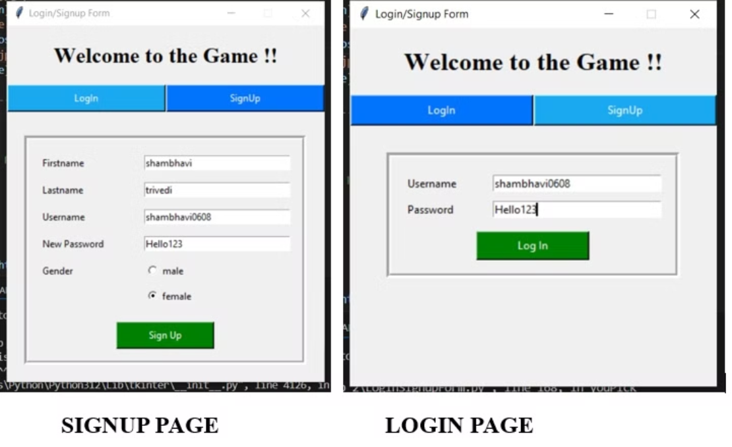
OUTPUT:
SCREENSHOTS:

Slide 7
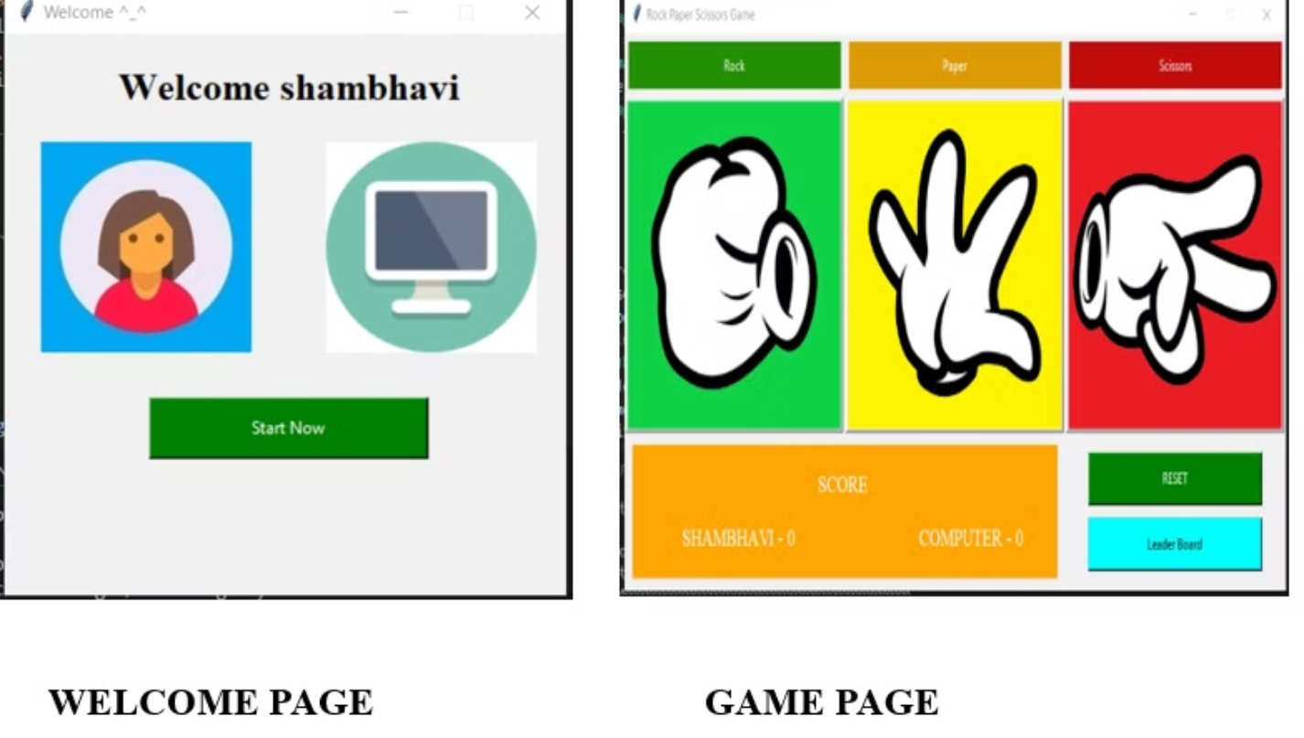

Slide 8
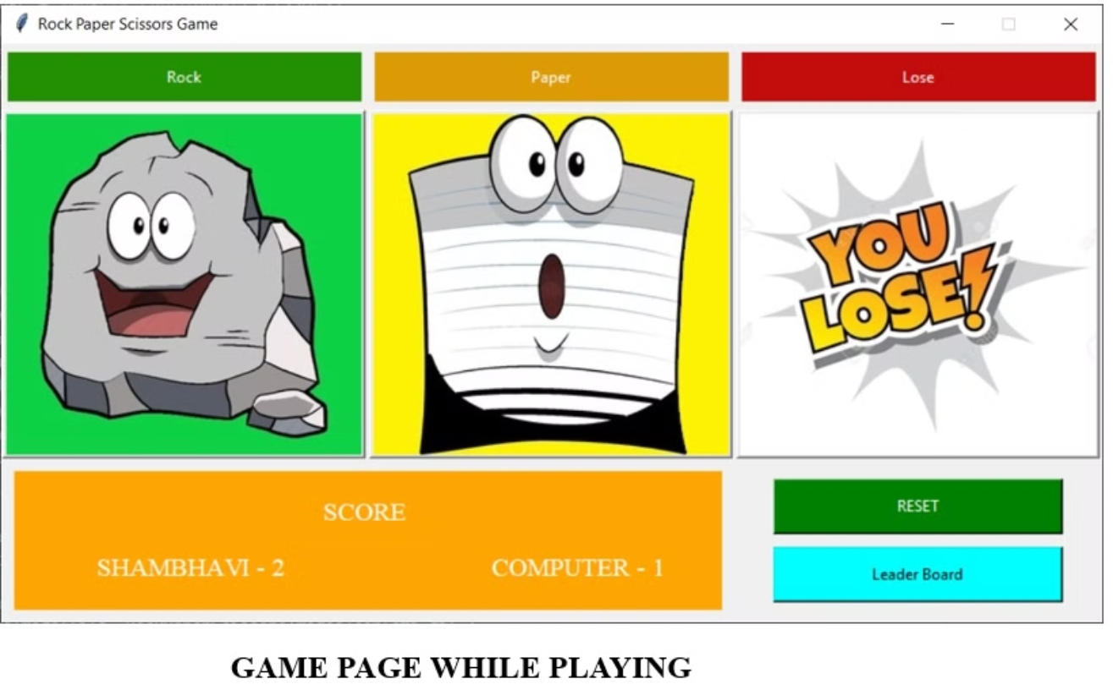

Slide 9
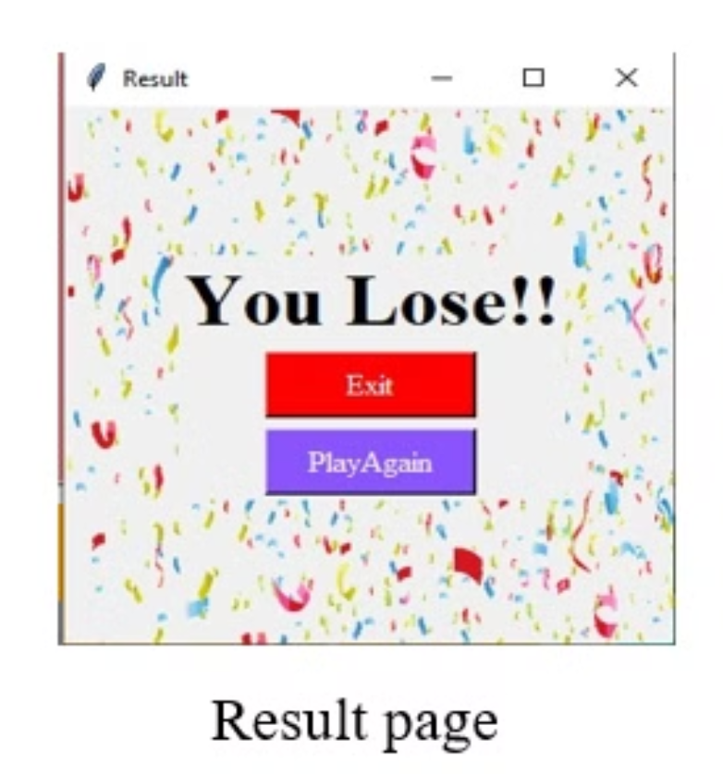

Slide 10
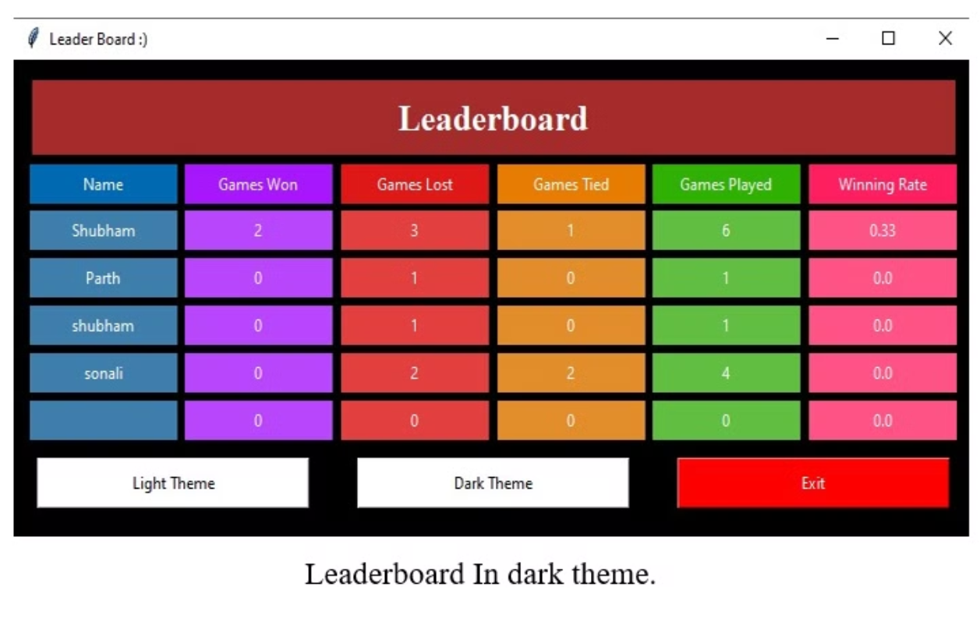

Slide 11

CONCLUSION
• Game is played between Computer (System) and user, so it can also be played when you are along (no need to wait for anyone).
• Also there will be leaderboard which will keeps you challenging by showing number of matches won, number of matches losed.
• Also it can be played anywhere to relax and refresh mind by just opening in computer system.

Slide 12




Future Scope:
Advanced game mechanics
GUI development
AI integration
Network-based play
Create a graphical user interface using libraries like Tkinter or PyGame.
Implement basic AI to adapt or improve computer decisions.
Implement additional features like best-of-five rounds, scoring systems, or multiplayer modes.
Expand the game to support online multiplayer via socket programming.

Slide 13
REFERENCES
• https://www.tutorialspoint.com/python/python_gui_programming.htm#:~:text=Tkinter% 20Programming,to%20the%20Tk%20GUI%20toolkit.
• https://www.geeksforgeeks.org/python-gui-tkinter/
• https://youtu.be/EPwszp6Ecgs

Slide 14


